Slide 1
The role of VEGFA in disease progression of myelodysplastic syndrome
Shin Seung-Hwan, M.D., Ph.D.

Slide 2
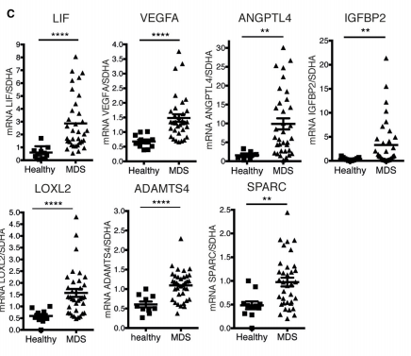
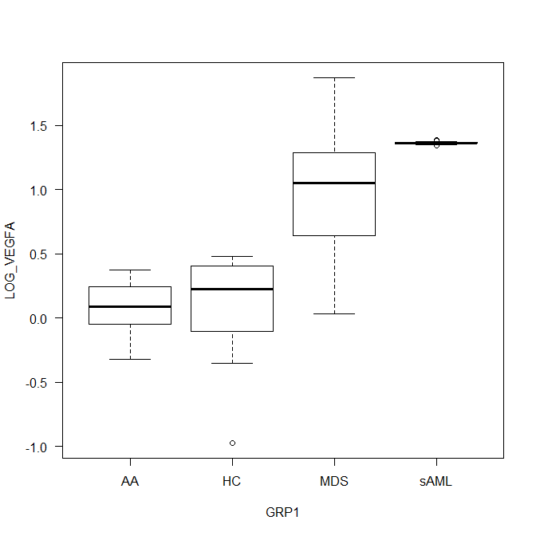
Background (Preliminary data)
VEGF mRNA expression in myelodysplastic syndrome mesenchymal stem cells
P < 0.01
AA
HC
MDS
sAML
Group | No. | Median (Lowest-Highest)
AA | 8 | 0.09 (-0.32 – 0.38)
Healthy control | 18 | 0.23 (-0.98 – 0.48)
MDS | 84 | 1.05 (0.03 – 1.88)
sAML | 17 | 1.36 (1.34 – 1.39)
Overproduction of niche factors such as CDH2 (N-Cadherin), IGFBP2, VEGFA, and LIF is associated with the ability of (lower-risk) MDS MSCs to enhance MDS expansion.
Cell Stem Cell. 2014 Jun 5;14(6):824-37.

Slide 3
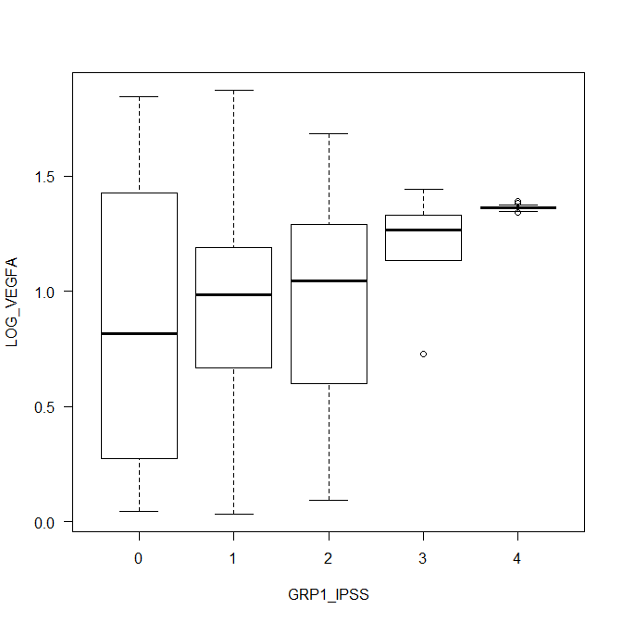
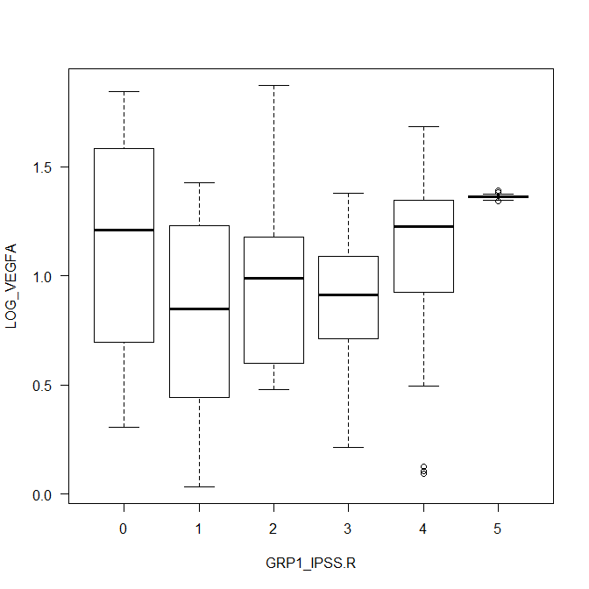
Background (Preliminary data)
VEGF mRNA expression in myelodysplastic syndrome mesenchymal stem cells
P < 0.01
P < 0.01
Low
Int-1
Int-2
High
sAML
VLow
Low
Int
High
VHigh
sAML
IPSS | No. | Median (Lowest-Highest)
Low | 6 | 0.82 (0.04-1.84)
Int-1 | 43 | 0.99 (0.03-1.88)
Int-2 | 29 | 1.04 (0.09-1.69),
High | 6 | 1.27 (0.73-1.44)
sAML | 17 | 1.36 (1.34-1.39)
IPSS-R | No. | Median (Lowest-Highest)
Very low | 4 | 1.21 (0.30-1.84)
Low | 16 | 0.85 (0.03-1.43)
Int | 20 | 0.99 (0.48-1.88)
High | 20 | 0.91 (0.21-1.38)
Very high | 24 | 1.23 (0.09-1.69)
sAML | 17 | 1.36 (1.34-1.39)

Slide 4
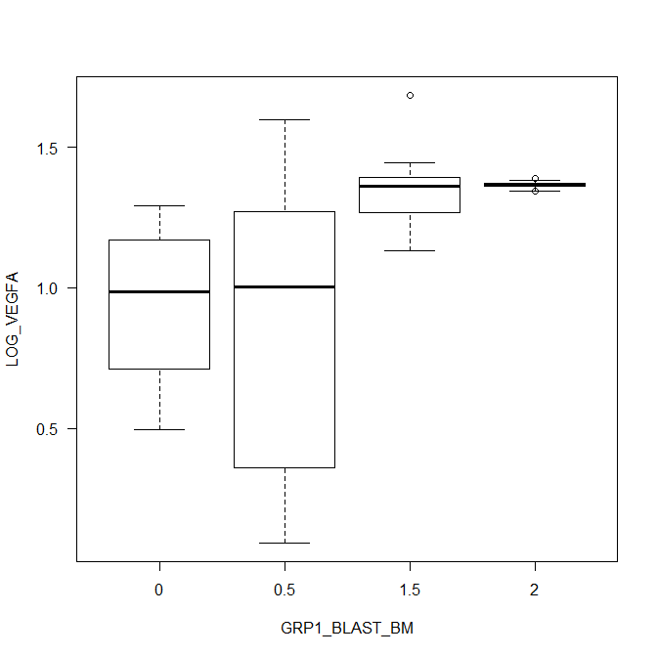
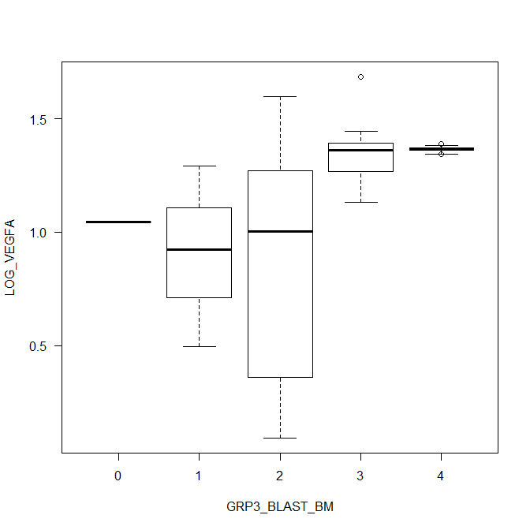
Background (Preliminary data)
VEGF mRNA expression in myelodysplastic syndrome mesenchymal stem cells
P < 0.01
P < 0.01
<5
5-10
11-20
>20
≤2
2-5
5-10
10-20
>20
Blast by IPSS | No. | Median (Lowest-Highest)
<5 | 46 | 0.93 (0.03-1.84)
5-10 | 27 | 1.02 (0.09-1.88)
11-20 | 13 | 1.33 (0.73-1.69)
>20 | 15 | 1.36 (1.37-1.39)
IPSS-R | No. | Median (Lowest-Highest)
≤2 | 32 | 1.05 (0.03-1.84)
2.1-4.9 | 14 | 0.84 (0.04-1.43)
5-10 | 27 | 1.02 (0.09-1.88)
10.1-20 | 13 | 1.33 (0.73-1.69)
>20 | 15 | 1.36 (1.34)-1.39

Slide 5
Background (Angiogenesis)
Area of controversies – cell or tissue other than mesenchymal stem cell
References | No. | Method | Findings | Angiogenesis and MDS risk correlation
Leuk Res. 2006 Mar;30(3):247-53. | 53 | BM MVD | MDS > Healthy control (P = 0.02) Highest in RAEB group (P = NS) BM blast (P = NS) MVD not ∝ OS | not checked
Am J Clin Pathol. 2013 Mar;139(3):380-7. | 79 | VEGF levels (VEGFi) = Cellularity × VEGF+ CD34+ cells by IHC | VEGFi – Very high risk (WPSS) > Very low risk (WPSS) (P = 0.01) Poor or Intermediate karyotype > Good karyotype (P = 0.015) High VEGFi ∝ T/F dependency (OR 10.38; 95% CI 1.02– 106.0), Poor LFS and OS | + correlation
Leukemia. 2008;22:530-537. | 128 | Circulating endothelial cells (CEC) by flow-cytometry | CEC – MDS > Control (P < 0.01) CEC ∝ -IPSS (R = -0.55, P <0.01) CEC ∝ MVD (R = 0.62, P <0.01) Progenitor-to-mature CEC ratio = MDS > Control (P <0.01) CEC ∝ ECFC (Endothelial colony-forming cells) (R= 0.57, P = 0.02) ECFC – MDS > Control (P = 0.01) | - correlation
Pathol Oncol Res. 2012 Jul;18(3):681-90. | 71(50) 31(20) | MVD BM VEGF (IHC) | MVD – MDS > Control (P = 0.03) VEGF expression – MDS ≒ Control MVD ∝ survival (P = 0.02), not ∝ in multivariate analysis VEGF expression not ∝ survival | not checked

Slide 6
Background (Angiogenesis)
Area of controversies – cell or tissue other than mesenchymal stem cell
References | No. | Method | Findings | Angiogenesis and MDS risk correlation
Br J Haematol. 2007 May;137(3):206-15. | 9 10 10 8 | MVD qRT-PCR (MNC) | MVD – MDS & de novo AML > Control , MDS > MDS OL, de novo AML > MDS OL Angiogenic mediator gene expression (VEGF, bFGF, TNFα, HFG, Ang-1, Ang-2) & receptors of angiogenic mediators (VEGFR2, TIE2) – MDS & de novo AML > Control, de novo AML > MDS (MDS ≒ MDS OL) Anti-angiogenic mediator gene expression (TGFβ) – MDS OL > de novo AML | - correlation
Br J Haematol. 2002 Jul;118(1):151-6. | 41 66 | Western blot Radioimmunoassay (BM mononuclear cells) | VEGF – MDS > AML (P < 0.01) VEGFR-1 – AML > MDS (P < 0.01) VEGFR-2 – AML ≒ MDS (P = 0.50) VGEFR-1, VEGFR-2 not ∝ survival, VEGF ∝ -survival VEGF ∝ VEFGR-2 in AML and MDS (P < 0.01), VEGF not ~ VEGFR-1 | - correlation
Leuk Lymphoma. 2017 Jul;58(7):1711-1720. | 188 96 | VEGF (IHC) VEGF (BM plasma level & supernatant) | VEGF – MDS > Control (P < 0.01), low risk ≒ high risk VEGF level ∝ Apoptotic rate (P < 0.01) VEGF release – low risk > high risk (P < 0.05) VEGF level ∝ Apoptotic rate (P < 0.01) VEGF level ∝ OS, PFS | - correlation

Slide 7
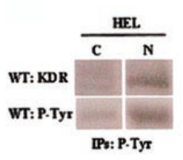
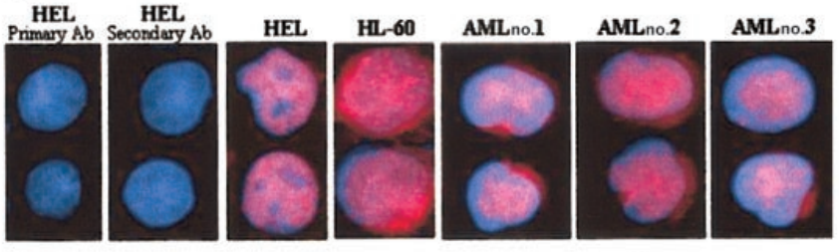
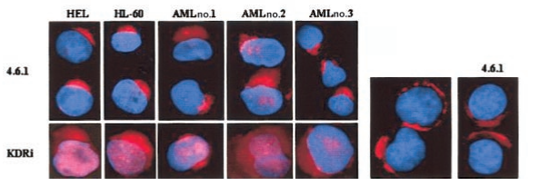
Background (mechanism other than angiogenesis)
Internal and external autocrine VEGF/VEGFR2 loops
Phosphorylated VEGFR2 in the nuclear protein fractions of untreated cells, suggesting the autocrine loop might result in VEGR2 activation
Blood. 2004 May 15;103(10):3883-9.

Slide 8
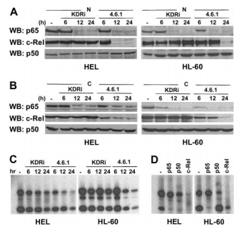
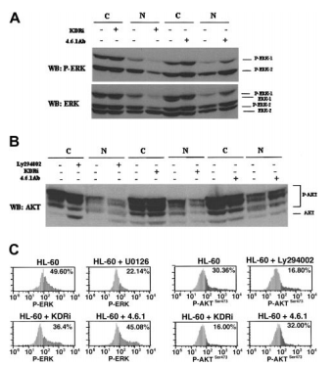
Background (mechanism other than angiogenesis)
Internal and external autocrine VEGF/VEGFR2 loops
Anti-VEGF Ab. blocks NF-κB
VEGFR2-specific intracellular inhibitor (4.6.1) blocks MAP3 and PI3K pathway
Blood. 2004 May 15;103(10):3883-9.

Slide 9
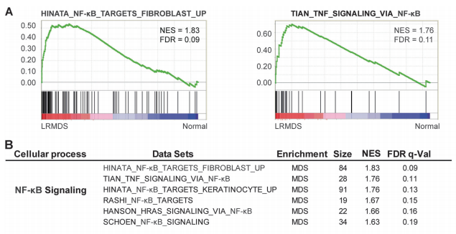
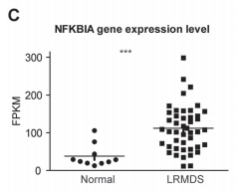
Background (mechanism other than angiogenesis)
Activation of NF-κB driven inflammatory programs in mesenchymal elements attenuates hematopoiesis in lower-risk MDS
Gene set enrichment assay (GSEA) – a remarkable abundance of signatures related to the activation of the nuclear factor-kappa B (NF-κB) family of transcription factors
Leukemia. 2019 Feb;33(2):536-541.

Slide 10
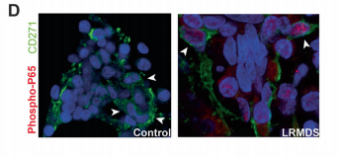
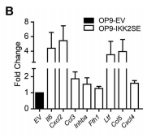
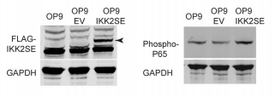
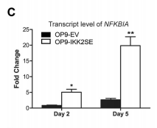
Background (mechanism other than angiogenesis)
Activation of NF-κB driven inflammatory programs in mesenchymal elements attenuates hematopoiesis in lower-risk MDS
Increased phosphorylation of p65 in intramedullary located CD271+ mesenchymal cells
OP9 cells (like CD271+ cells) – support the expansion of human HSPCs
IKK2SE – a constitutively active form of IKK2 (a upstream regulator of NF-kB)
Transfection by lenti-virus
Leukemia. 2019 Feb;33(2):536-541.

Slide 11
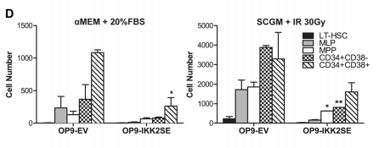
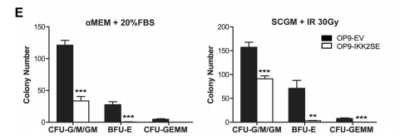
Background (mechanism other than angiogenesis)
Activation of NF-κB driven inflammatory programs in mesenchymal elements attenuates hematopoiesis in lower-risk MDS
Leukemia. 2019 Feb;33(2):536-541.

Slide 12
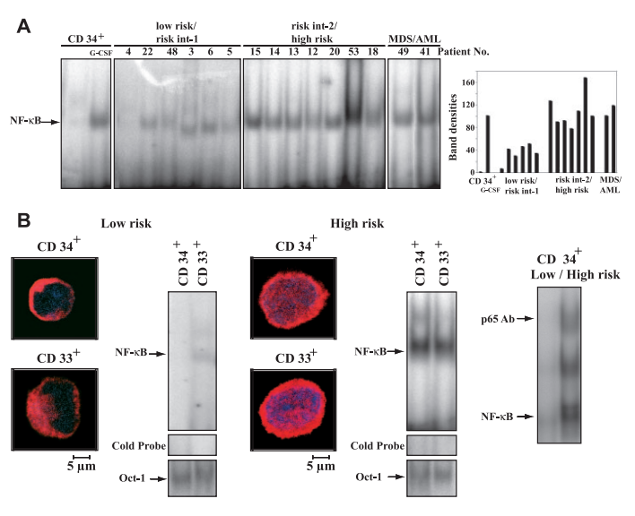
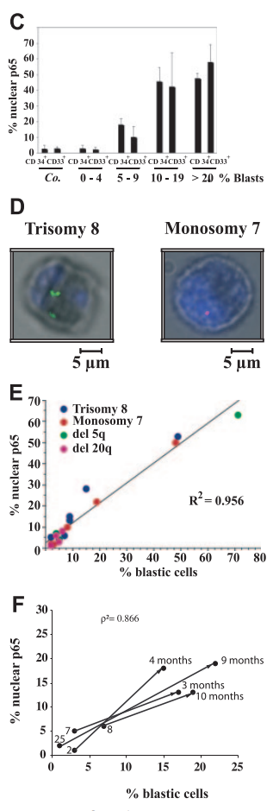
Background (mechanism other than angiogenesis)
NF-kB activation in bone marrow samples from (esp. high risk) MDS patients
Blood. 2006 Feb 1;107(3):1156-65.

Slide 13
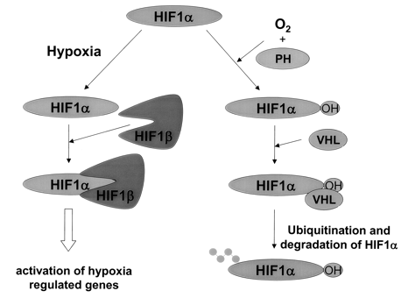
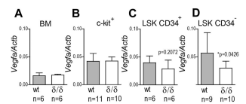
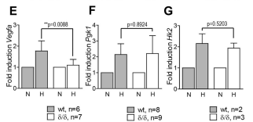
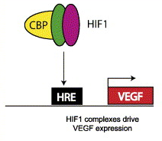
Background (mechanism other than angiogenesis)
Hypoxic induction of VEGF regulates murine HSC function in the low-oxygenic niche
Mature cells
Hypoxia
Blood. 2006 Feb 1;107(3):1156-65.

Slide 14
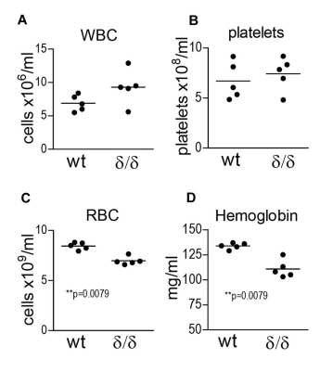
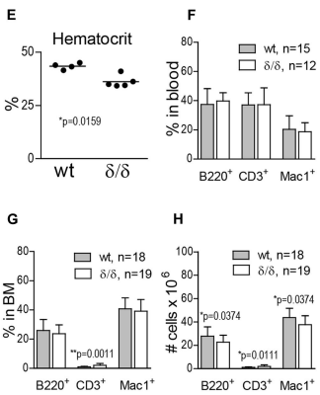
Background (mechanism other than angiogenesis)
Hypoxic induction of VEGF regulates murine HSC function in the low-oxygenic niche
Blood. 2006 Feb 1;107(3):1156-65.

Slide 15
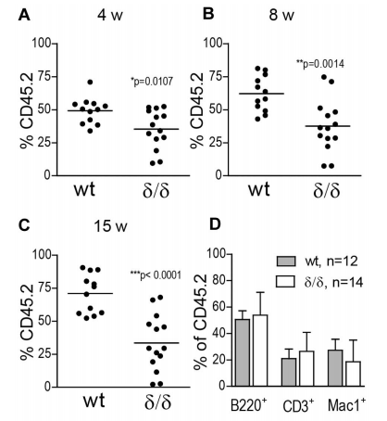
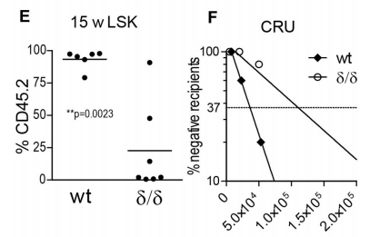
Background (mechanism other than angiogenesis)
Hypoxic induction of VEGF regulates murine HSC function in the low-oxygenic niche
Blood. 2006 Feb 1;107(3):1156-65.

Slide 16
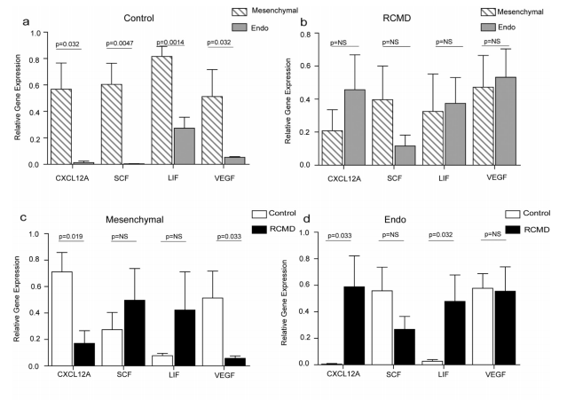
Background (mechanism other than angiogenesis)
Coexistence of aberrant hematopoietic and stromal elements in MDS
Blood Cells Mol Dis. 2017 Jul;66:37-46.

Slide 17
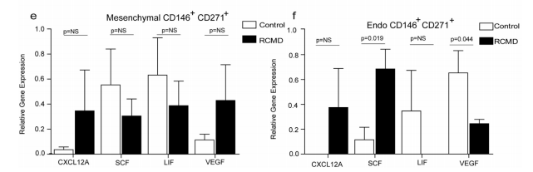
Background (mechanism other than angiogenesis)
Coexistence of aberrant hematopoietic and stromal elements in MDS
Blood Cells Mol Dis. 2017 Jul;66:37-46.

Slide 18
Background (MSC)
Area of controversies – mesenchymal stem cell
References | No. | Method | Findings | Angiogenesis and MDS risk correlation
Cell Stem Cell. 2014 Jun 5;14(6):824-37. |  |  | LIF, VEGFA, ANGPT4, IGFBP2, LOXL2, SPARC, ADAMTS4 – lower-risk MDS > healthy | + correlation
Blood. 2011 Aug 11;118(6):1534-43 |  |  | VEGFA expression – ↓ in VEGF^{δ/δ} mouse, ↑ HSC and HSPC, ↓ HSC function | not checked

Slide 19
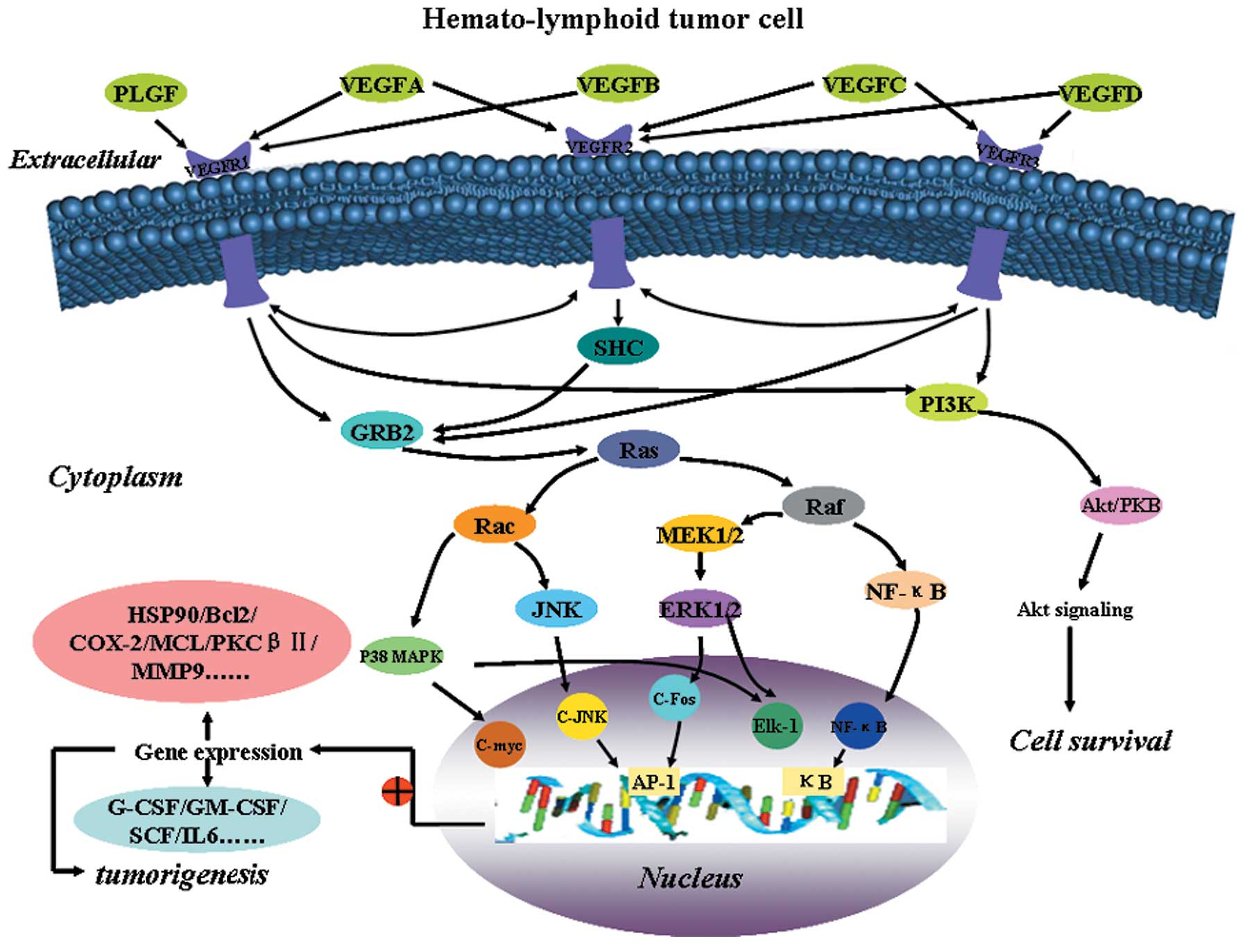
Background (molecular target of VEGFs)
Oncol Rep. 2012 Dec;28(6):1935-1944.

Slide 20
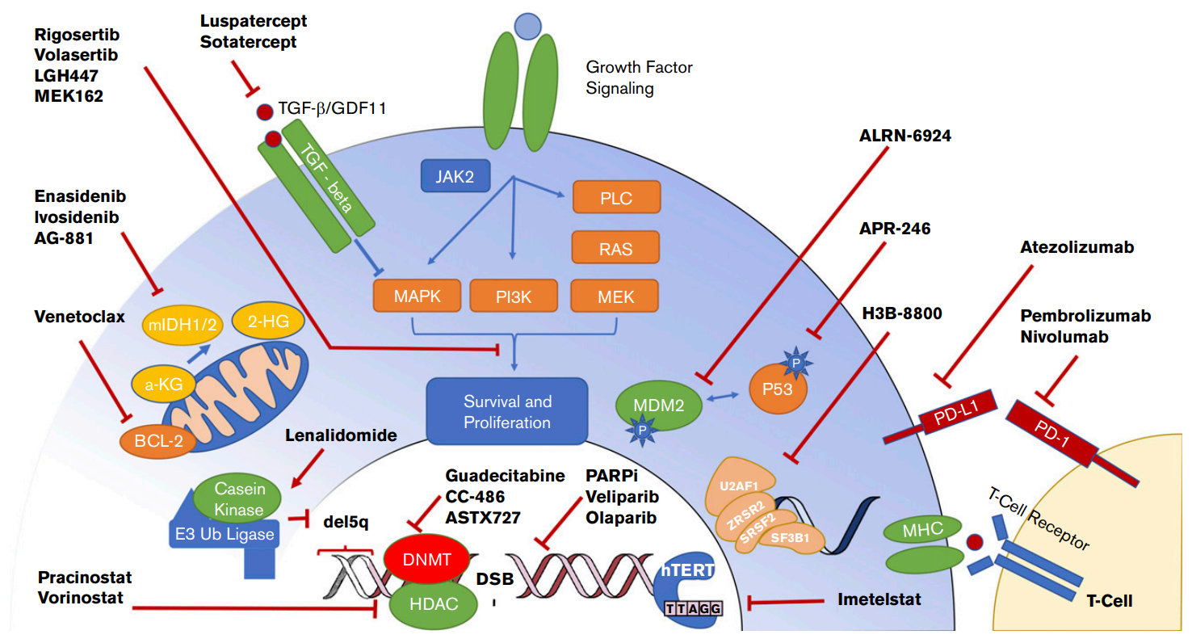
Background (molecular target of VEGFs)
Molecular targets and therapeutics in myelodysplastic syndrome
Blood Adv. 2018 Oct 23;2(20):2787-2797.

Slide 21
Hypothesis
MDS MSC
VEGF increase in higher risk
Angiogenesis
controversies
Other mechanism?
Hematopoiesis or Leukemogenesis
NF-Kb or MAPK/PI3K
Other pathway
1. Protein level expression
2. Protein release
3. Exosome
1. Characteristics of MSC (VEGF_{low} vs. VEGF_{high})
Flow phenotype, passage, CFU-F, differentiation
2. Normal and malignant cells the impact of MSC (VEGF_{low} vs. VEGF_{high}) on normal and malignant cells
Proliferation, apoptosis, cell cycle, CFU assay, flow (CD34), chemo-resistance, cell line clonal assay

Slide 22
Hypothesis
Known | Unknown
1. MDS MSC VEGF mRNA expression is roughly proportional to MDS disease risk. (our preliminary data) 2. VEGF inhibits NF-kB pathway in AML cell lines and leukemic cells. Anti-VEGF inhibitor – reduce leukemic cells proliferation, only with VEGFR2 intra-cellular Ab. | 1. No evidence of direct association of VEGF and NF-kB activation
3. Increased NF-Kb in lower-risk MDS MSC 4. NF-Kb (HC) was activated in lower-risk MDS, higher-risk MDS, and AML NF-kB activation reflects BM blast counts | NF-Kb (MSC): lower vs higher Role of NF-Kb (MSC) on leukemic cells NF-kB in MDS MSC & its relations from the viewpoint of risk group ?
Hypothesis
1. More MDS MSC VEGF mRNA expression will result in more MDS MSC VEGF protein expression. 2. MDS MSC VEGF will reflect MDS MSC function. 3. Will MSC with higher VEGF activate NF-kB activity of leukemic cells?

Slide 23
EXPERIMENTAL DESIGN
Preliminary study
VEGF gene expression
VEGF protein expression
Changes in MSCs by
VEGF Expression
Leukemogenesis by VEGF expression
Flow cytometry
(intra-cellular staining)
Western blot
ELISA
1. Stemness
- RQ-PCR / Western blot
(stemness-related gene; nanog, oct-4)
- CFU-F
2. Differentiation
- Osteogenesis
- Chondrogenesis
- Adipogenesis
1. Clonogenic assay
Further study
Changes in HSC by Leukemic MSCs

Slide 24
The role of VEGFA in disease progression of myelodysplastic syndrome
Sample selections in MDS VEGF_{high} and VEGF_{low} groups
VEGF_{low}
UPN | 14 | 68 | 57 | 9 | 15
RQ-PCR | 2.014 | 1.636 | 4.485 | 1.235 | 5.333
BM blast | 1 | 5 | 7 | 9 | 14
UPN | 30 | 51 | 50
RQ-PCR | 3.972 | 3.568 | 10.375
BM blast | 9 | 8 | 10
VEGF_{high}
UPN | 32 | 80 | 1 | 8 | 79
RQ-PCR | 23.588 | 26.723 | 24.001 | 75.061 | 27.858
BM Blast | 1 | 4 | 7 | 10 | 15
UPN | 116 | 115 | 125
RQ-PCR | 23.265 | 23.04 | 22.925
BM Blast | 40 | 95 | 27

Slide 25

The role of VEGFA in disease progression of myelodysplastic syndrome
E1 – Comparing VEGFA protein expression in MDS VEGF_{high} and VEGF_{low} MSC cells
Method
Flow cytometry with intra-cellular protein staining
Western blot
Enzyme-linked immunosorbent assay (ELISA)
VEGF_{high}
VEGF_{low}
VEGF protein expression

Slide 26
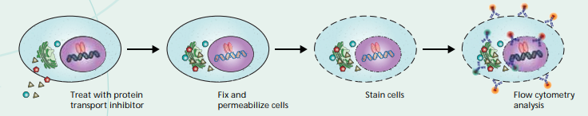
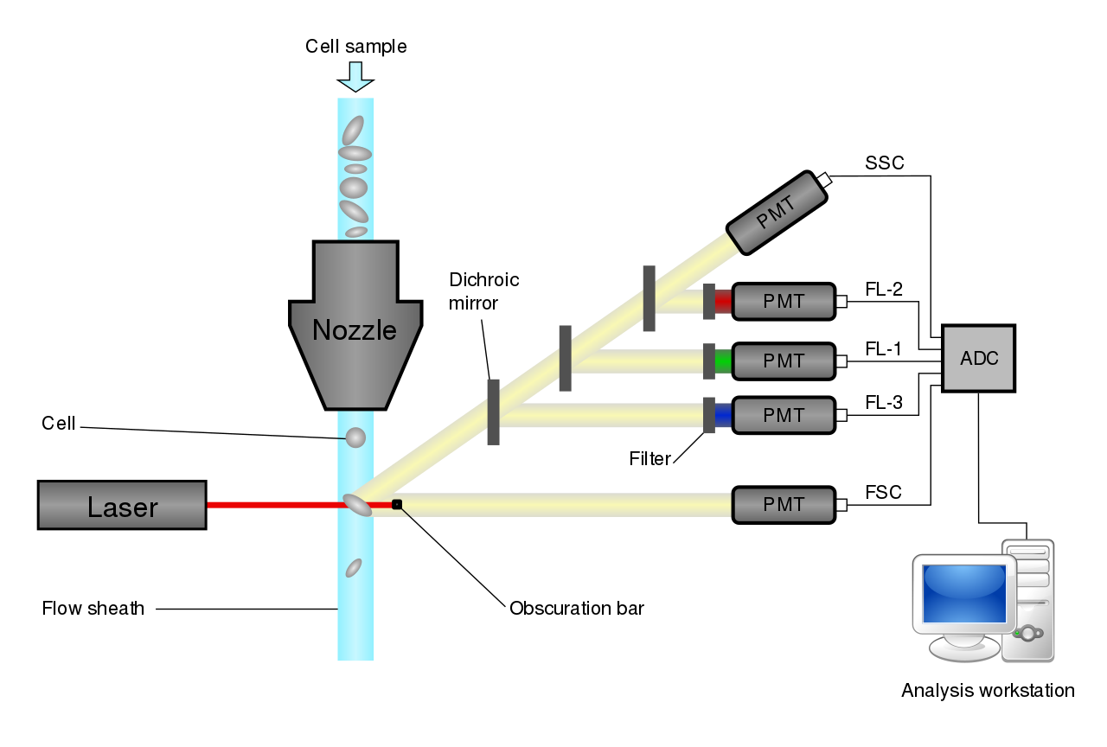
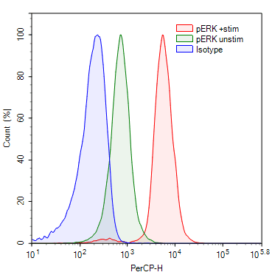
The role of VEGFA in disease progression of myelodysplastic syndrome
E1 – Comparing VEGFA protein expression in MDS VEGF_{high} and VEGF_{low} MSC cells
Method
Flow cytometry with intra-cellular protein staining

Slide 27
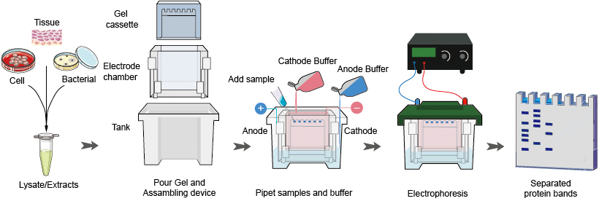
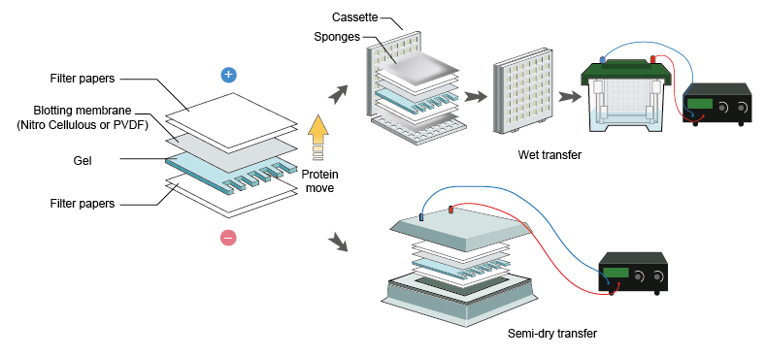
The role of VEGFA in disease progression of myelodysplastic syndrome
E1 – Comparing VEGFA protein expression in MDS VEGF_{high} and VEGF_{low} MSC cells
Method
Western blot

Slide 28
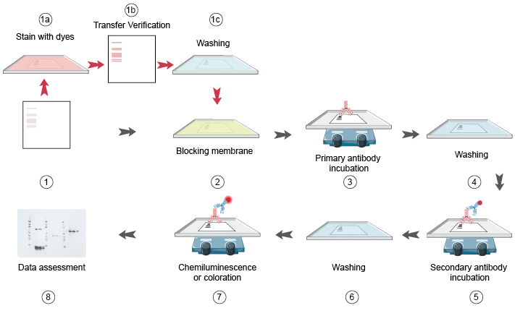
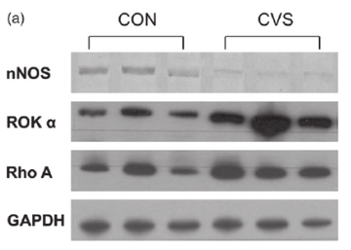
The role of VEGFA in disease progression of myelodysplastic syndrome
E1 – Comparing VEGFA protein expression in MDS VEGF_{high} and VEGF_{low} MSC cells
Method
Western blot

Slide 29

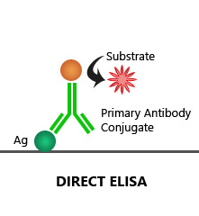

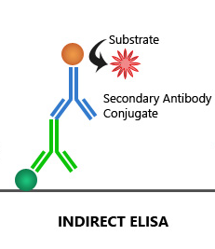
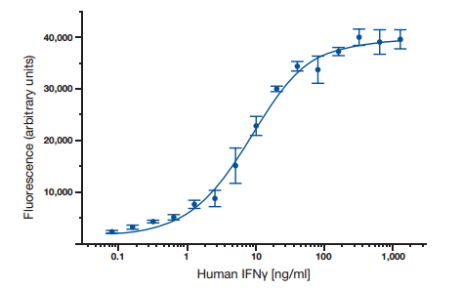
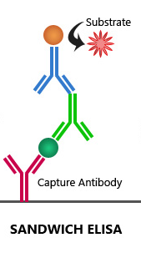
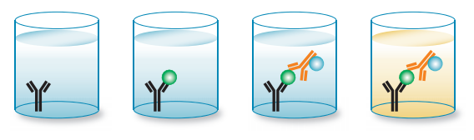
The role of VEGFA in disease progression of myelodysplastic syndrome
E1 – Comparing VEGFA protein expression in MDS VEGF_{high} and VEGF_{low} MSC cells
Method
Enzyme-linked immunosorbent assay (ELISA)

Slide 30

The role of VEGFA in disease progression of myelodysplastic syndrome
E2 – Comparing normal MSC cell function according to MDS VEGF_{high} and VEGF_{low} MSC cells co-culture
Method
Cell proliferation
Stemness (self-renewal)
Differentiation
VEGF_{high} MSC
VEGF_{low} MSC

Slide 31
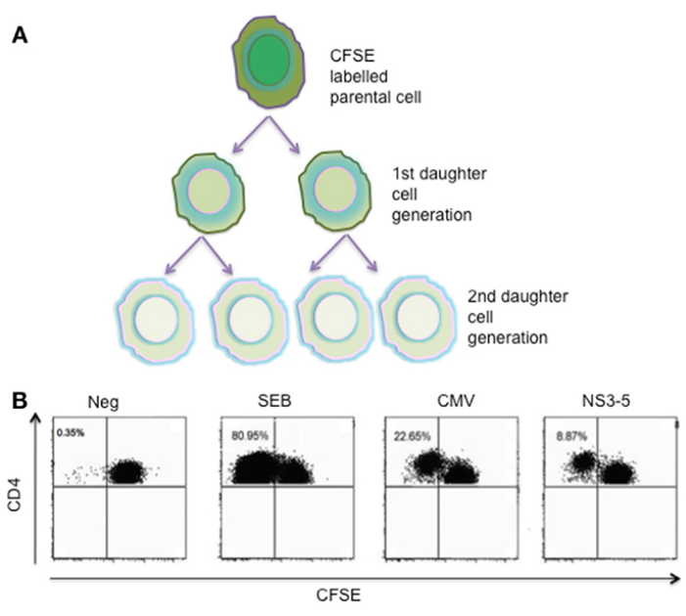
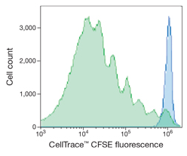
The role of VEGFA in disease progression of myelodysplastic syndrome
E2 – Comparing normal MSC cell function according to MDS VEGF_{high} and VEGF_{low} MSC cells co-culture
Method
Cell proliferation – CFSE assay

Slide 32
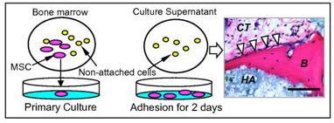
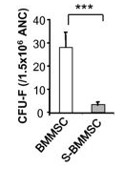
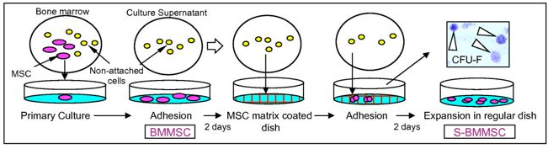
The role of VEGFA in disease progression of myelodysplastic syndrome
E2 – Comparing normal MSC cell function according to MDS VEGF_{high} and VEGF_{low} MSC cells co-culture
Method
Stemness (self-renewal) – CFU-F assay

Slide 33

The role of VEGFA in disease progression of myelodysplastic syndrome
E2 – Comparing normal MSC cell function according to MDS VEGF_{high} and VEGF_{low} MSC cells co-culture
Method
Differentiation

